Slide 1



Digital Electronics
Class X
lab 19

Slide 2
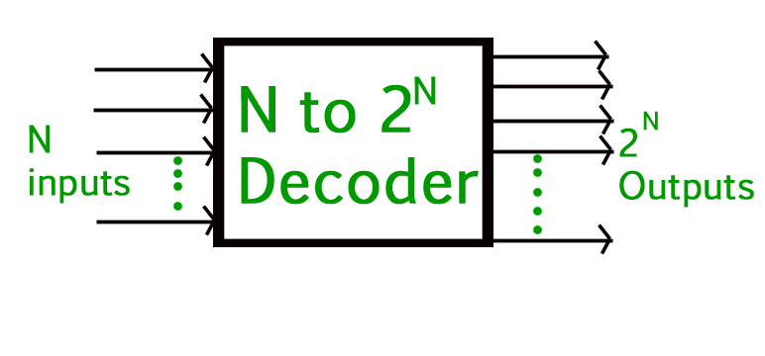
Decoder
Decoder is a combinational circuit that has ‘n’ input lines and maximum of 2^{n} output lines.

Slide 3
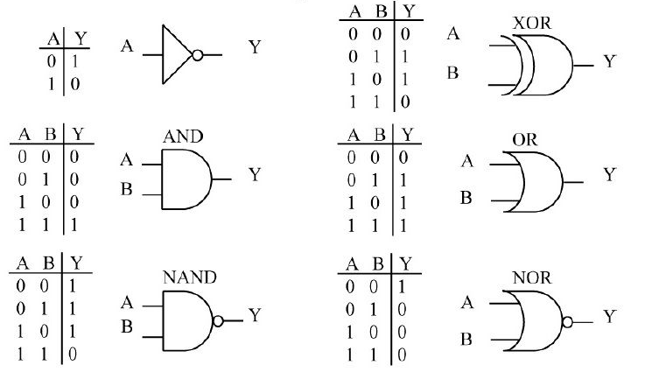
Input and Output for Basic Logic Gates

Slide 4
Truth Table
A | B | AB
0 | 0 | 0
0 | 1 | 0
1 | 0 | 0
1 | 1 | 1
Truth table is a tabular representation of all the combinations of values for inputs and their corresponding outputs.

Slide 5
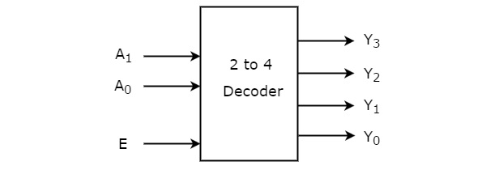
2 to 4 Decoder
Let 2 to 4 Decoder has two inputs A1 & A0 and four outputs Y3, Y2, Y1 & Y0. The block diagram of 2 to 4 decoder is shown in the following figure

Slide 6
Truth Table for 2 to 4 Decoder
Enable | Inputs |  | Outputs
E | A₁ | A₀ | Y₃ | Y₂ | Y₁ | Y₀
0 | x | x | 0 | 0 | 0 | 0
1 | 0 | 0 | 0 | 0 | 0 | 1
1 | 0 | 1 | 0 | 0 | 1 | 0
1 | 1 | 0 | 0 | 1 | 0 | 0
1 | 1 | 1 | 1 | 0 | 0 | 0

Slide 7
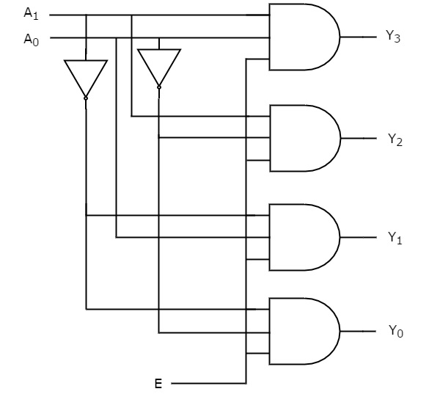
2 to 4 Decoder Diagram

Slide 8
Thank You

